Slide 1
Boosting

Slide 2
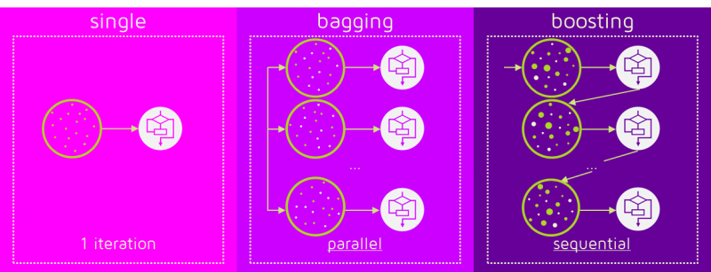
Introduction
The term ‘Boosting’ refers to a family of algorithms which converts weak learner to strong learners.
Boosting is an ensemble method for improving the model predictions of any given learning algorithm.
The idea of boosting is to train weak learners sequentially, each trying to correct its predecessor.

Slide 3
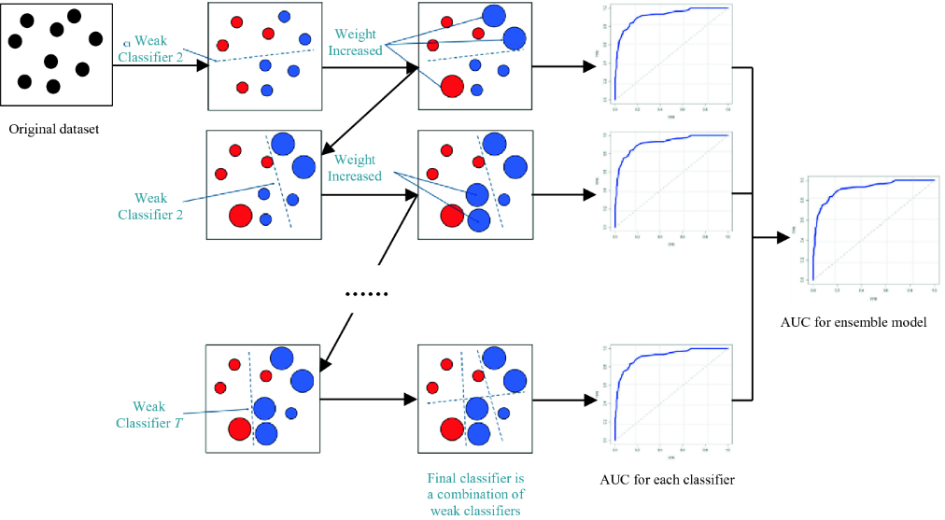
How Boosting Works
The base learner applies equal weights for all the observations.
If there is prediction errors, those observations are given higher priority & then the next base learning algorithm is applied upon
Run Step 2 until the highest accuracy is reached upon
Finally, it combines the outputs from weak learner and creates a strong learner which eventually improves the prediction power of the model.
Boosting pays higher focus on examples which are mis-classiﬁed or have higher errors by preceding weak rules.
Notes:
https://analyticsindiamag.com/adaboost-vs-gradient-boosting-a-comparison-of-leading-boosting-algorithms/

Slide 4
Boosting Type
AdaBoost : Adaptive Boosting
Gradient Boosting
XGBoosting : eXtreme Gradient Boosting
Notes:
https://www.mygreatlearning.com/blog/gradient-boosting/
https://www.analyticsvidhya.com/blog/2020/10/adaboost-and-gradient-boost-comparitive-study-between-2-popular-ensemble-model-techniques/

Slide 5
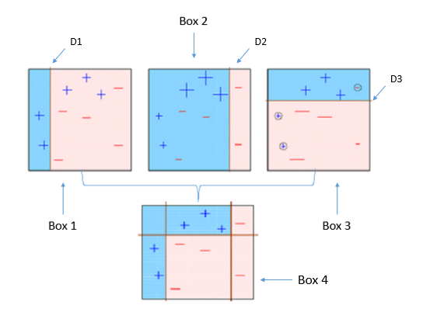
ADABOOST
A decision stump is a machine learning model consisting of a one-level decision tree.
It is a decision tree with one internal node (the root) which is immediately connected to the terminal nodes (its leaves).
A decision stump makes a prediction based on the value of just a single input feature.
D1 & D2 & D3 form a SEQUENCE of Weak Learners
The weightage of the observations will be altered according to the ‘Accuracy’ of predictions using the learners
It continues to add learner until a limit is reached in the number of models or accuracy.
Notes:
https://www.youtube.com/watch?v=kho6oANGu_A&t=544s

Slide 6
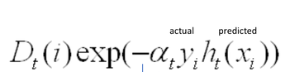
How AdaBoost Works
PREDICTED | 1 | 1 | -1 | -1
ACTUAL | -1 | 1 | -1 | 1
WEIGHTS | 0.5 | 0.2 | 0.1 | 0.04
CORRECT/INCORRECT | 1 | 0 | 0 | 1
MISCLASSIFICATION RATE | 1*0.5 | 0*0.2 | 0*0.1 | 1*0.04
Error Rate = Sum of Misclassification Rates/(Sum of weights)
= 0.54/0.84 = 0.642
α
=
1/2 * ln(1- error / error).
-0.22
INCORRECT
CORRECT
Exp(-0.22 * -1 * 1)
Exp(0.22)
=1.659
Exp(-0.22 * 1 * 1)
Exp(-0.22)
=0.6025

Slide 7
Adaboost Hyperparameters
base_estimators: specifies the base type estimator, i.e. the algorithm to be used as base learner.
n_estimators: It defines the number of base estimators, where the default is 10 but you can increase it in order to obtain a better performance.
learning_rate : same impact as in gradient descent algorithm
random_state : makes the model’s output replicable. It will always produce the same results when you give it a fixed value as well as the same parameters and training data.

Slide 8
Gradient Descent Boosting
Compared to AdaBoost (tweaks the instance weights at every interaction), GBM method tries to fit the new predictor to the residual errors made by the previous predictor.
A model is built on a subset of data.
Using this model, predictions are made on the whole dataset.
Errors are calculated by comparing the predictions and actual values.
A new model is created using the errors calculated as target variable. Our objective is to find the best split to minimise the error.
The predictions made by this new model are combined with the predictions of the previous.
New errors are calculated using this predicted value and actual value.
This process is repeated until the error function does not change, or the maximum limit of the number of estimators is reached.

Slide 9
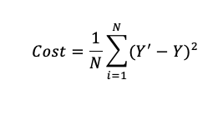
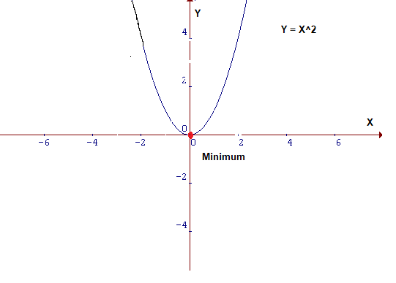
How GBM Works
A Cost Function/Loss Function evaluates the performance of our Machine Learning Algorithm.
The Loss function computes the error for a single training example while the Cost function is the average of the loss functions for all the training examples.
GOAL: To minimize the Cost Function
Gradient Descent is an iterative optimization algorithm used to find the minimum value for a function.

Slide 10
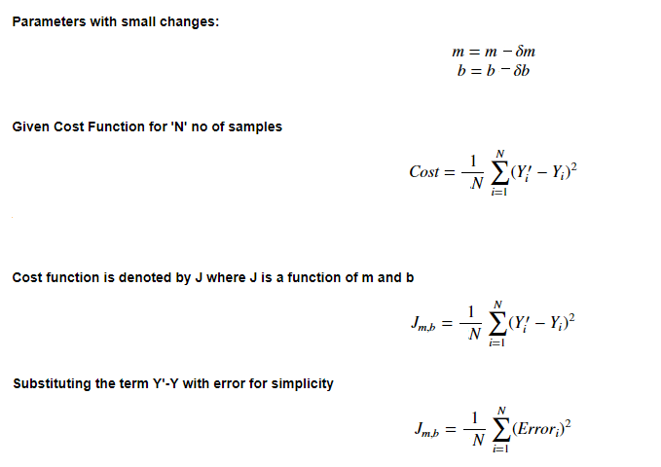
Cost Function & Line Representation

Slide 11
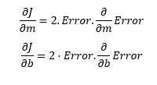
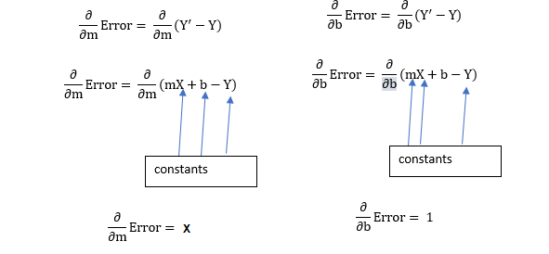
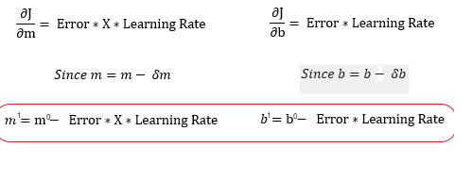
Minimization of Cost Function
m¹,b¹ = next position
m⁰,b⁰ = current position

Slide 12
Gradient Boosting Hyper parameters
min_samples_split: Minimum number of observation which is required in a node to be considered for splitting. It is used to control overfitting.
min_samples_leaf : Minimum samples required in a terminal or leaf node. Lower values should be chosen for imbalanced class problems since the regions in which the minority class will be in the majority will be very small.
min_weight_fraction_leaf : similar to the previous but defines a fraction of the total number of observations instead of an integer.
max_depth : maximum depth of a tree. Used to control overfitting.
max_lead_nodes : maximum number of terminal leaves in a tree. If this is defined max_depth is ignored.
max_features : number of features it should consider while searching for the best split.

Slide 13
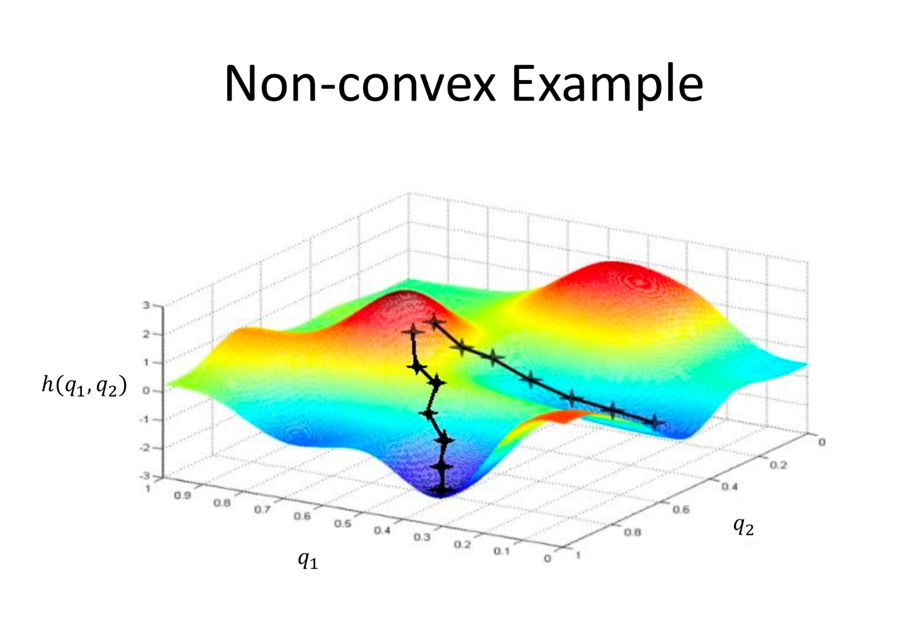
GRADIENT DESCENT

Slide 14
Extreme Gradient Boosting
XGBoost is a decision-tree-based ensemble Machine Learning algorithm that uses a gradient boosting framework.
It is a perfect combination of software and hardware optimization techniques to yield superior results using less computing resources in the shortest amount of time.
Parallelization: XGBoost approaches the process of sequential tree building using parallelized implementation.
Tree Pruning: XGBoost uses ‘max_depth’ parameter as specified instead of criterion first, and starts pruning trees backward.
Hardware Optimization: This algorithm has been designed to make efficient use of hardware resources.

Slide 15
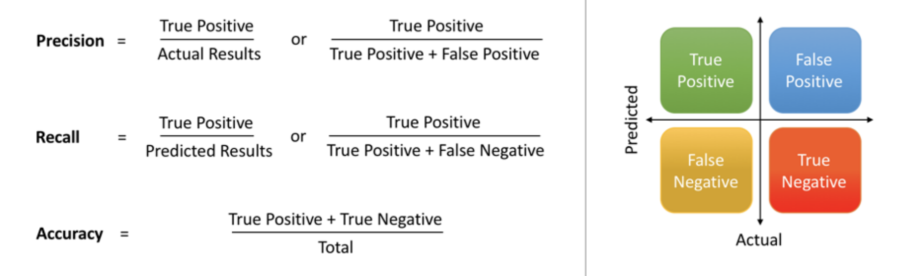
Model Evaluation Metrics
The various metrics used to evaluate
the results of the prediction are :
Accuracy
Precision
Recall
Area Under ROC Curve
MAPE/ MAD/ RMSE (For Regressors)

Slide 16
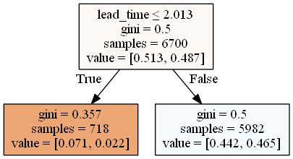
Adaboost Decision Stump

Slide 17
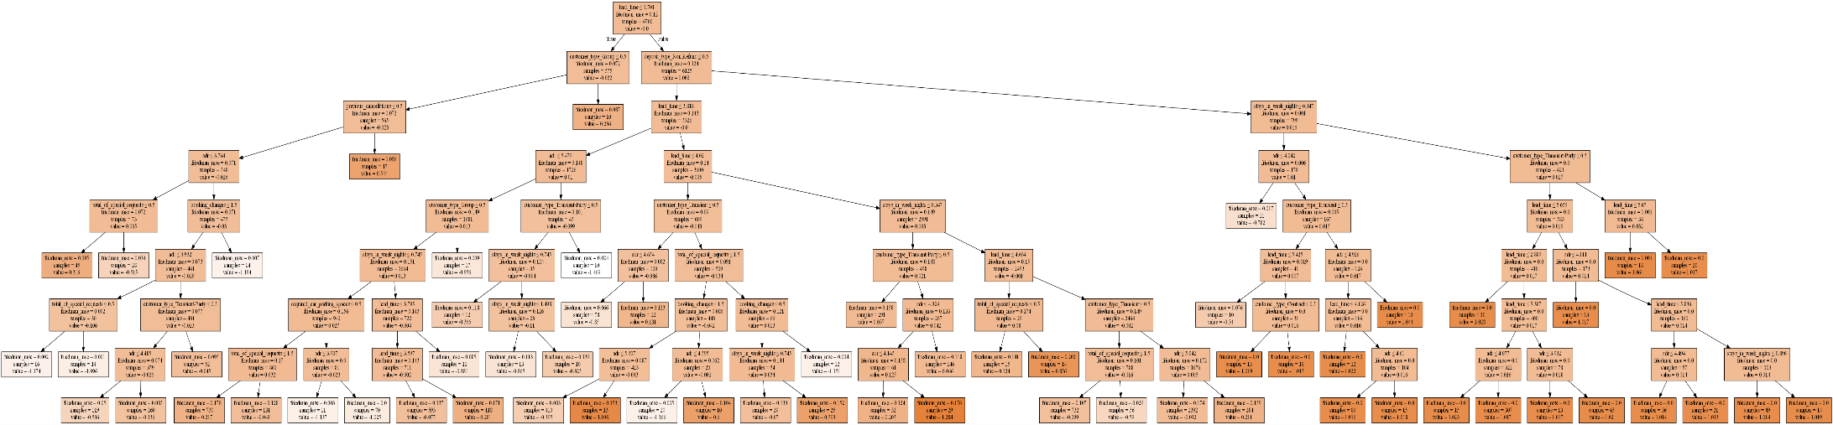
GBM Plot

Slide 18
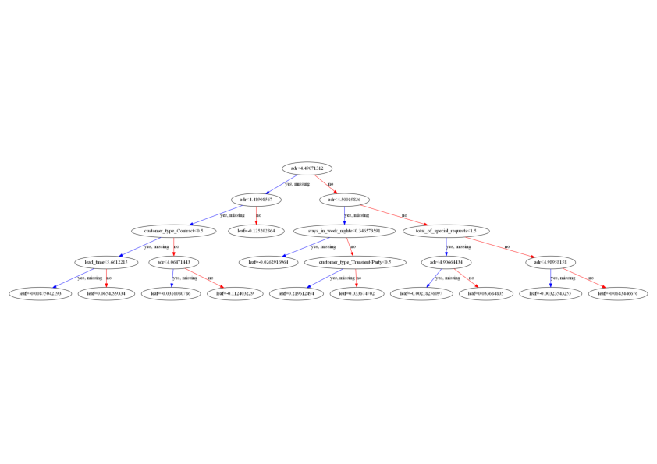
XGBoost Output

